Slide 1
Employee Management System
TEAM MEMBER
K . Deepthi(2010030450)
G . Pavan Reddy(2010030501)
S. Padma Shree (2010030508)

Slide 2
CONTENT
Introduction
Aim of the Project
Work Allocation
Literature Survey
GitHub Setup
Conclusion
References

Slide 3
INTRODUCTION
Employee Management System is a distributed application developed to maintain the details of employee working in any organization.
The EMS has been developed to override the problem prevailing in the practicing manual system.
It maintains the information about the personal and official details of the employees.
The idea of EMS mainly aims to maintain the database of the employees working in an institute with their profile, leaves and reports with a facility to edit and update it. The EMS project facilitates user as per their hierarchy and grants privilege to them accordingly. Our Project aims in designing EMS which could effectively maintain a database which has the details of the staff such as their name, unique id, image, designation, date of joining , qualification and certification , journals published etc. EMS is a well detail processing which provides updated records of the employees also accumulated leaves. EMS allows the users to register basic data in a very simple and easy way and the admin can access the stored, analysis and then generate the customize report.

Slide 4
Work Allocation
G. Pavan Reddy:- Information collection, Frontend
Padma Shree:- Frontend, Backend
Deepthi Sri:- Database Connectivity

Slide 5
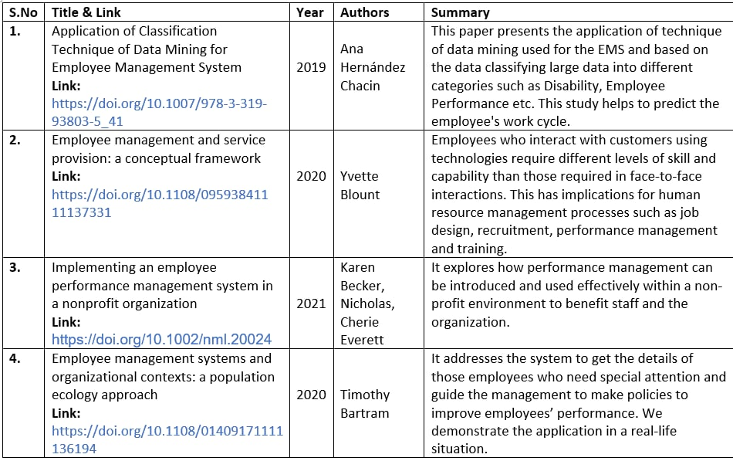
Literature Survey

Slide 6
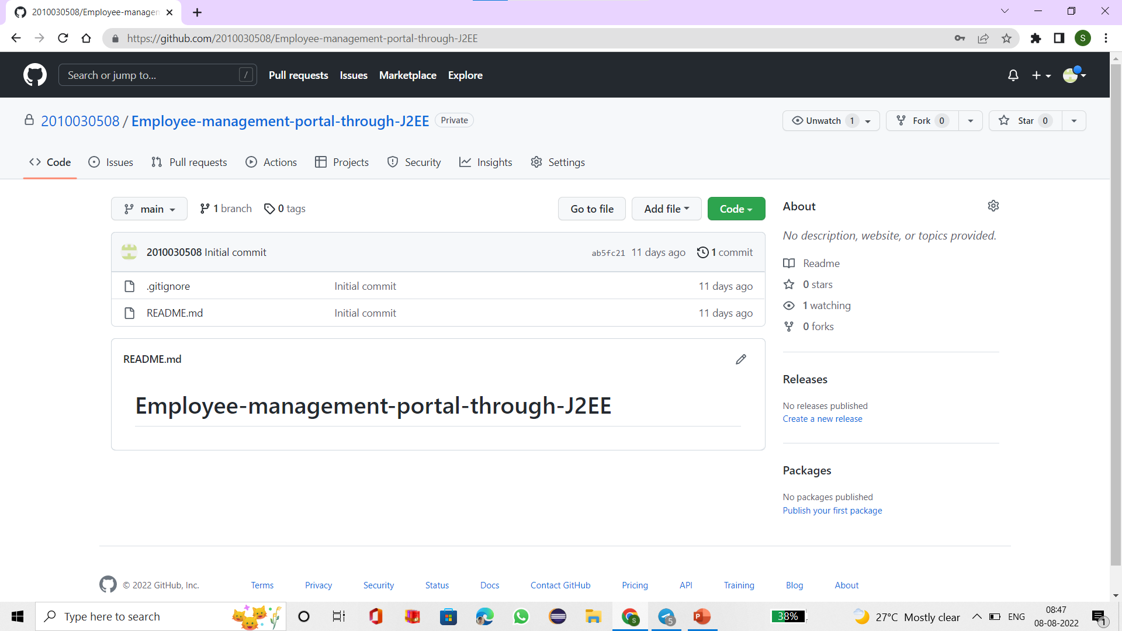
GitHub Setup

Slide 7
CONCLUSION
The idea of EMS mainly aims to maintain the database of the employees working in an institute with their profile, leaves and reports with a facility to edit and update it. The EMS project facilitates user as per their hierarchy and grants privilege to them accordingly. Our Project aims in designing EMS which could effectively maintain a database which has the details of the staff such as their name, unique id, image, designation, date of joining , qualification and certification , journals published etc. EMS is a well detail processing which provides updated records of the employees also accumulated leaves. EMS allows the users to register basic data in a very simple and easy way and the admin can access the stored, analysis and then generate the customize report.

Slide 8
REFERENCES
Kamatkar, Sadhana J., Amarapali Tayade, Amelec Viloria, and Ana Hernández-Chacin. "Application of classification technique of data mining for employee management system." In International conference on data mining and big data, pp. 434-444. Springer, Cham, 2019.
Blount, Yvette. "Employee management and service provision: a conceptual framework." Information Technology & People 24, no. 2 (2011): 134-157.
Becker, Karen, Nicholas Antuar, and Cherie Everett. "Implementing an employee performance management system in a nonprofit organization." Nonprofit management and leadership 21, no. 3 (2017): 255-271.
Bartram, Timothy. "Employee management systems and organizational contexts: a population ecology approach." Management Research Review (2011).

